Slide 1

NYS Emergency Medical Services CME 4 year Recertification Program Update
2025

Slide 2

Suffolk County CME Program
The Suffolk County Emergency Medical Services (EMS) Division’s New York State Department of Health, Bureau of EMS and Trauma Systems (NYS DOH-BEMSATS) Continuing Medical Education (CME) Program is under the medical direction of the Suffolk County Medical Director.
Each of the Division’s contracted agencies has a Memorandum of Understanding (MOU) with the Suffolk County EMS Division.

Slide 3
NYS BEMSATS/Suffolk County CME Program
The MOU states that each agency agrees to authorize its personnel certified as Certified First Responders (CFR), Emergency Medical Technician-Basics (EMT-B), Advanced Emergency Medical Technicians (AEMT),Emergency Medical Technician-Critical Cares (EMT-CC), and Emergency Medical Technician-Paramedics (EMT-P) to participate in the program consistent with the rules and regulations established for the program by the NYS DOH-BEMSATS and the Suffolk County EMS Division.

Slide 4
Agency CME Coordinator
The agency must designate a CME Coordinator to oversee the CME Program.
The CME Coordinator will be in charge of each one of their Agency’s registered participants. It is their responsibility to make sure each participant is following the rules and regulations of the CME Program.

Slide 5
Responsibilities of the CME Coordinator include…
Track the progress of all participants by reviewing their progress at regular intervals (at a minimum of every 3 months), and (if need be) notifying the participant in a timely manner that they will be unable to renew their certification via CME and must complete a NYS DOH traditional refresher course.
Documentation of these notifications and verification of receipt by the participant must be maintained in the participant file.
Properly prepare, verify, and submit all agency CME Program paperwork to SCEMS within the required timelines.

Slide 6
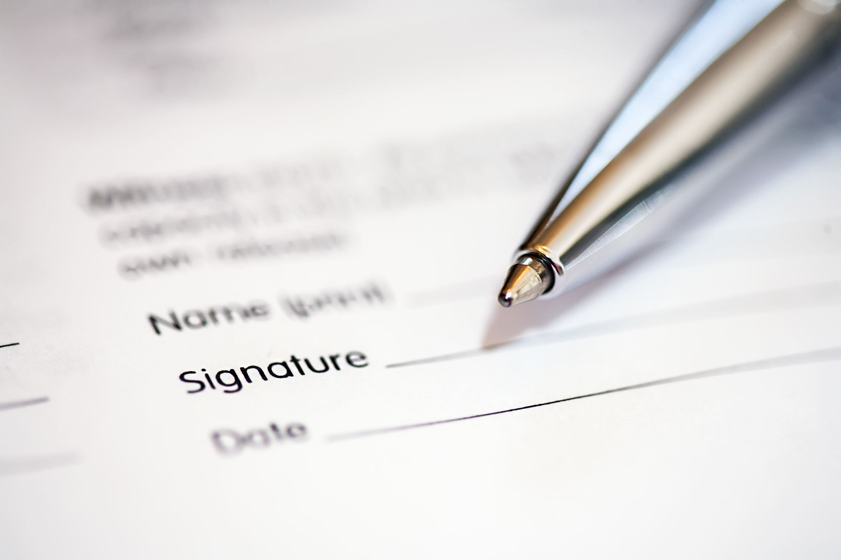
How to Register for CME recertification
The registration form is the first page of the tracking form.
When you register for the first time, please fill out the first page, make a copy for your files, and send a copy to Raegin Kellermann so we can generate a file.

Slide 7
Register for CME Recertification
provider initial here
provider sign here
provider sign here
Leave this blank
Email completed forms to Raegin Kellermann
coordinator sign here

Slide 8
Types of CME
Core (Core content from NYS Curriculum)
Non Core (anything related to EMS provider practice)
Skills Competency Verification
Healthcare Provider CPR/AED certification;
All ALS providers must also have proof of ACLS and PALS or PEPP (or equivalent).

Slide 9
Mandatory Non-Core Classes
1 hour- Mental Health of the EMT.
1 hour- Patient Lifting, Moving and Transport
1 hour - Safe Transport of the Pediatric Patient
2 hours- Emergency Vehicle Operations
https://collabornation.net/nyems

Slide 10
Mandatory Non-Core may also be taught in house!
Opportunity to review your specific Agency policies/procedures on:
maintaining mental health in your Agency,
Agency lifting and moving devices,
Agency pediatric transport devices, and
Agency hands-on driver training practice.
Please submit an outline describing the session and any handouts or reference materials provided to the SCEMS Division PRIOR to the first training session for approval.

Slide 11

Obtaining Core CME Hours
Suffolk EMS-Sponsored Classes:
Can be found on the Suffolk REMSCO website under “CME Courses”
Agency-Approved Core Classes:
Must be taught by a CIC at or above the level of the Core class.
Must be pre-approved by SCEMS.
If you have any questions on approval of CME classes, please contact Dina Wayrich or James MacDonell

Slide 12
Online Core Content
The SCEMS Division has entered into an MOU with NYS BEMSATS to allow our providers refreshing through the Division to complete up to 100% of their CME refresher training online.
Please contact your CME Coordinator to register, then click here
Most on-line CAPCE Approved classes at your level of certification can be submitted for core content. For specific questions, email Dina Wayrich or James MacDonell

Slide 13
Ways of Obtaining Non-Core Hours
Agency drills and in-service EMS training.
EMS Conferences (may contain some Core - refer to specific conference brochure/registration forms)
Hospital or Healthcare sponsored EMS events.
Alphabet course refreshers (BCLS,ACLS,PALS,PEPP,etc.)
Self-Study Activities (Web-based learning (C, NC))

Slide 14

How to document NC hours
List each topic or course, indicate the source, the date of completion and the CME hours earned for that training session.
When listing National Courses, list the name of the course and the source, hours earned to complete the course, and the date of completion.

Slide 15
How to document NC hours
Attendance to Conferences and Seminars can earn several hours towards the additional CME requirements.
When listing these CME’s on your application please list the conference name, topics attended, and CME hours earned.
EMS World Expo
Drug Overdoses | 09.28.22 | 1.5hrs
LGBT & Gender Identity | 09.28.22 | 1.5hrs
EMS Providers Personal Mental Health | 09.28.22 | 1.5hrs

Slide 16

CME Class Cancellations
Any core class that does not have a minimum of ten providers signed up for it may be cancelled.
Any non-core class that does not have a minimum of fifteen providers signed up for it may be cancelled.
Registrants will be contacted by SCEMS.

Slide 17
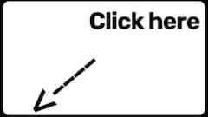
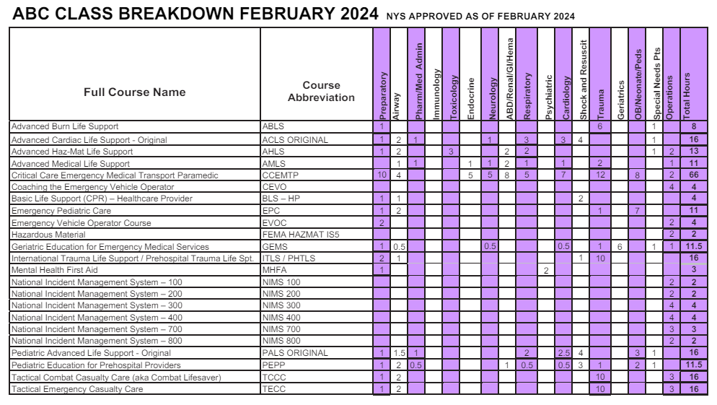
Alphabet Courses (as this changes, we will update the Suffolk REMSCO website)

Slide 18

CME SKILLS
NYS Practical Skills Exam station sheets MUST accompany final CME submissions. They can be downloaded from the suffolkremsco.com website, under Downloads & Forms.
The skills sheets must be completed and signed off by one of the following :
A NYS CIC at or above the level of the provider being tested.
The provider’s Agency Medical Director.

Slide 19

Submitting Completed Paperwork
Once all CME requirements are completed by the provider, they must meet with the agency CME Coordinator to review the paperwork for completion and complete a check off list.
The Coordinator will fill out and sign the CME Coordinator’s Verification Form, then give it to the provider to submit with final paperwork.
(Suggested completion deadline: At least 90 days prior to provider certification expiration.)

Slide 20
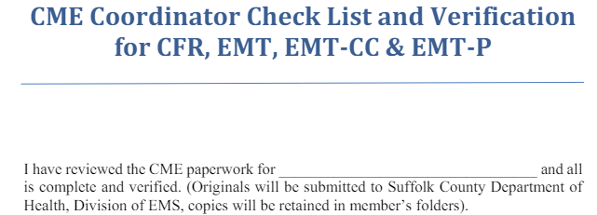
CME Coordinators have access to this document in the CME Coordinators area of the Suffolk REMSCO website.

Slide 21
What to submit to the CME Coordinator
Completed online recertification form. The form will be signed by the provider when they meet with SCEMS for their final review.
A copy of the eCard or copies of BOTH sides of the signed CPR card.
Practical Skills Evaluation Sheets for all required skills.
Paramedics and CC’s must also provide verification of course completion in ACLS and PALS (or equivalent) by submitting a photocopy of their current, non-expired, certification card.

Slide 22

What must I bring when I meet with SCEMS?
Completed online recertification form. The form will be signed by the provider at their appointment.
A copy of the eCard or copies of BOTH sides of the signed CPR card
Practical Skills Evaluation Sheets for all required skills.
Paramedics and CC’s must also provide verification of course completion in ACLS and PALS (or equivalent) by submitting a photocopy of their current, non-expired, certification card.
Signed CME Coordinator’s Verification Form.
45 Day Late Form* (if necessary)

Slide 23


Submitting Completed Paperwork
Meeting must be pre-arranged by clicking here, no walk-ins allowed.
Suggested meeting at SCEMS: 70 days prior to provider certification expiration.
MANDATORY deadline for meeting at SCEMS: no later than 60 days prior to provider certification expiration.

Slide 24

Timeline
At least 90 days prior to card expiration meet with CME Coordinator to finalize paperwork.
70 days meet with SCEMS to review/submit paperwork.
This process can be completed much earlier, as long as the paperwork is submitted to NYS BEMSATS no earlier than 9 months before card expiration.
All appointments scheduled after the 60 day mark will require a 45 day letter signed by an officer.

Slide 25

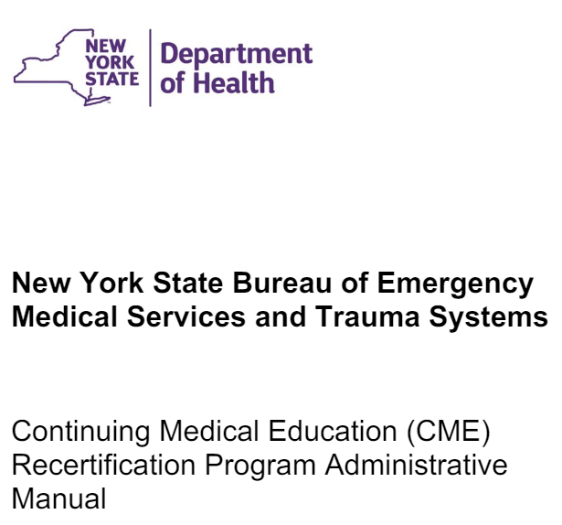

Maintaining CME Records
CME recertification program records must be maintained for a minimum of 7 years.
All agency and participant files must be kept up to date. Files found to be more than 30 days out of date will be in violation of the NYS BEMSATS program.

Slide 26
Maintaining CME Records
A CME training file must be kept for each CME Program participant. A training file must contain, but may not be limited to:
A copy of the participants current EMT card.
A copy of the completed participant registration form (DOH-4226) or first page of their tracking form.
Evidence of periodic assessment of participant status in the CME Program.
All Program records must be made available within 24 hours for auditing purposes by the Bureau of EMS and/or the New York State Office of the State Comptroller.
All CME documentation must be kept in chronological order.

Slide 27

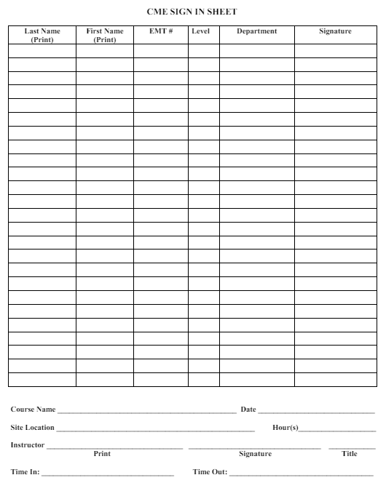

Maintaining CME Records
Documentation for CME hours earned must include:
proof of CME content,
proof of attendance, and
proof of participation.
A record of training provided in-house through drills and classroom sessions should be kept by maintaining a separate file within the CME records. This file should contain (for each session):
The date and location of the program, including the presenter’s name and qualifications.
An outline describing the session and any handouts or reference materials provided
An attendance sheet documenting the participant’s signature, time they arrived, and signature and time they left the class.

Slide 28

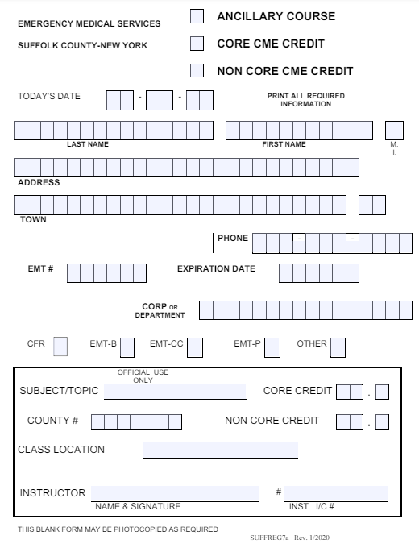
Maintaining CME Records
Each participant folder must have a certificate or documentation describing the drill or class session title or topic, completion date, number of earned CME hours, and evaluations if given.
If Core sessions are provided, they must use the triplicate form, including which topic area was presented.

Slide 29
Removal from the CME Recertification Program
Reasons for restricting, suspending, or revoking participation in the CME Recertification Program may include, but is not limited to, any of the following:
Falsifying CME records, such as:
classes attended;
duration of classes attended;
topic of classes attended, etc.
Failure to demonstrate proficiency at a skill after sufficient remediation;
Failure to complete assignments for any CME class;
Failure to participate in a CME class, topic, or evaluation;
Insubordination - related to the CME Recertification Program only;
Dishonesty - related to the CME Recertification Program only;
Inappropriate conduct during a CME class, lab or evaluation;
A change of status in employment (change to "inactive" or resignation from Agency.);
Failure to meet defined “continuous practice”;
Failure to remain in good standing with the respective REMAC;
Failure to demonstrate proficiency in the field.
Failure to meet your agency’s membership requirements
or failure to meet your Agency Requirements.

Slide 30
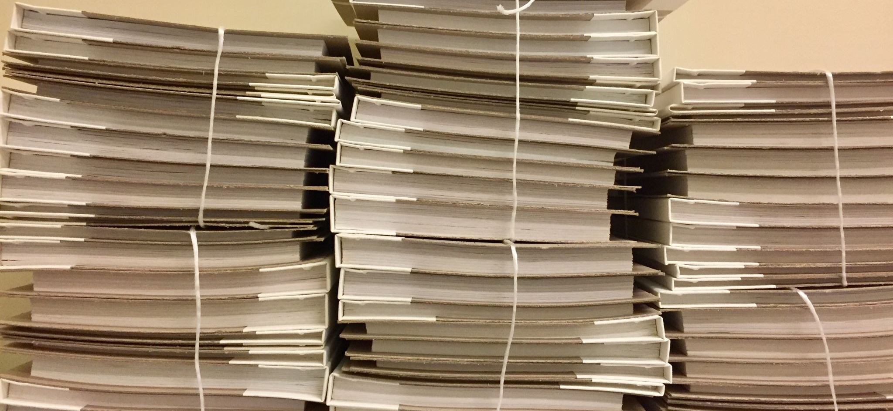
Did You Know…?
You can have your CME paperwork submitted up to 9 months prior to your expiration. If you want to close out your CME responsibilities for the term you can meet earlier with your Coordinator, then earlier with SCEMS and have your CME renewal completed in plenty of time.

Slide 31
Late Paperwork
The 60-days-prior deadline allows the Division time to sufficiently review the paperwork for completion and/or revision, which allows the applicant time to make modifications that, if there are deficiencies, might still make the paperwork acceptable by the 45-day mark.
If the appointment with SCEMS is past the 60 day mark, the applicant must request a 45-day-late submission form. This form can only be obtained through the CME Coordinator, and the provider is granted the opportunity based upon the provider’s Agency policy.
Submitting this form does NOT guarantee that the paperwork will be accepted as late. NYS BEMSATS has the ultimate authority to make this determination.

Slide 32
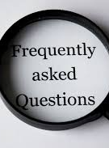
My department doesn’t have a CME Coordinator at the moment. What should I do?
Contact Dina Wayrich or James MacDonell
If I become a CME Coordinator, where are there resources that I can use to perform my functions?
All resources can be found on the Suffolk REMSCO website under CME Courses then CME Coordinators Area. A username and password is required.

Slide 33


I have switched agencies. How do I get my CME paperwork transferred?
The provider must first fill out the top part and initial the first page of a tracking form and submit to the new agency’s CME Coordinator as well as SCEMS.
The provider shall then request a letter (that is on agency letterhead) from the former agency outlining all training within that provider’s file, including hours earned, topics, and skills completion. The provider is allowed to make copies of anything they need but may not remove the original training documents from the former agency.

Slide 34

What happens after I submit my paperwork to SCEMS?
SCEMS will send you an email stating that they submitted your paperwork to NYS BEMSATS.
Once you receive your new provider card, send a copy of it to SCEMS. You will then be automatically re-registered for the CME Program.
All ALS providers must send in a copy of your renewed card or your advanced level certification and ALS privileges will be suspended.
If you have not received your new card by your expiration date, contact SCEMS.

Slide 35

FAQ
How much earlier can I take a refresher course or renew through the CME Program?
NYS BEMSATS will allow refresher course renewal as long as there are no more than 18 months remaining on the provider’s certification.
NYS BEMSATS will allow CME recertification as long as there are no more than 9 months remaining on the provider’s certification.

Slide 36


Can I use alphabet original courses for Core credit?
Yes. Original alphabet courses (ACLS, PALS, etc.) can count for Core CME credit.
Providers must provide proof that it was an original course.
Can I use alphabet refresher courses for Core credit?
No. Refresher courses can count for non- core credit only.
Exception to this: A CIC who is also the IC for the course can breakdown the refresher into core topics themselves.

Slide 37

FAQ
Do I need to recertify my CPR (ACLS & PALS or PEPP) card if my current one expires before my CME recertification deadline?
A photocopy of the most current, not expired, CPR (ALS- ACLS & PALS or PEPP) card must be submitted with your application
Do ICS classes count towards core hours?
Yes, if taken during the current refresher period. See the most current letter course breakdown here.

Slide 38

Does an NYS CIC have to teach Non-Core classes?
No. They are intended to expand upon the basic knowledge learned in an original EMS course
Records of CME sessions must be kept by the Agency, faxed to the Suffolk County EMS Division and include: date of session; topic(s) covered & outline; instructors name and signature; actual time spent in training; and copy of the presentation.

Slide 39


Can a BLS provider take an ALS Core class for Non-Core credit?
Yes.
Can an ALS provider take a BLS core class for Non-Core credit?
No.
Can a provider take the same class once for Core, then again for Non-Core?
No.

Slide 40

Some suggestions…
Require members to hand in all completed CME sheets to the CME Coordinator within 30 days.
Require members to meet with the CME Coordinator no less then 6 months before their expiration or the agency will not submit CME.
Have members sign that they will follow the Agency’s requirements to participate in the Agency CME Program or the Agency will require the provider to take a traditional refresher.

Slide 41

Questions or Comments?

Slide 42
THANK YOU!

