Slide 1
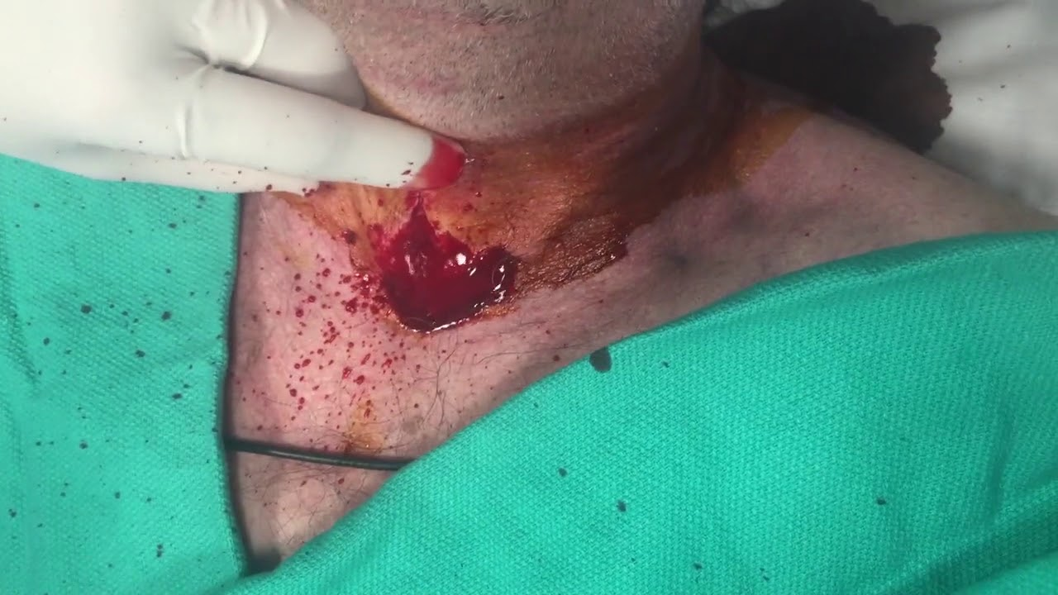
Surgical Airway for EMS
Educational program
The Suffolk County Regional Emergency Medical Advisory Committee and the Rapid Sequence Intubation Subcommittee
Suffolk County Program Agency
July 1, 2025

Slide 2

Objective of this Introduction:
To help train Suffolk County Paramedics how and when to preform a surgical cricothyroidotomy in the field; including indications, contraindications, and technique.

Slide 3
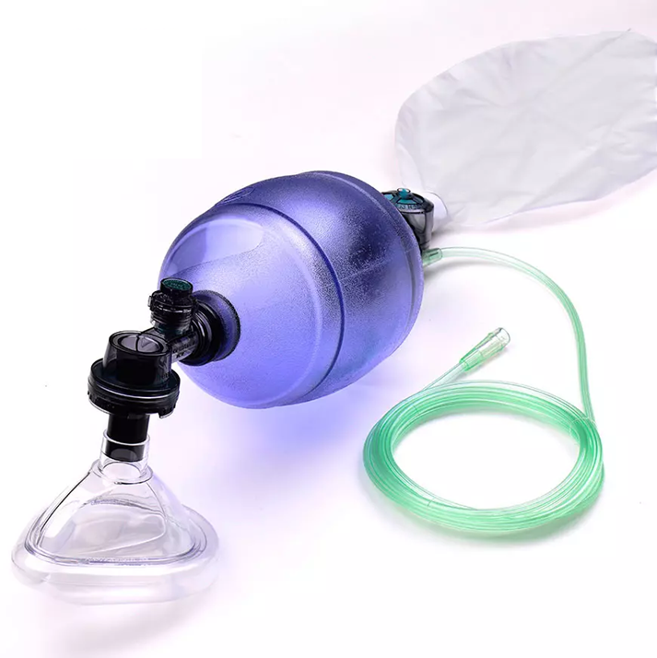
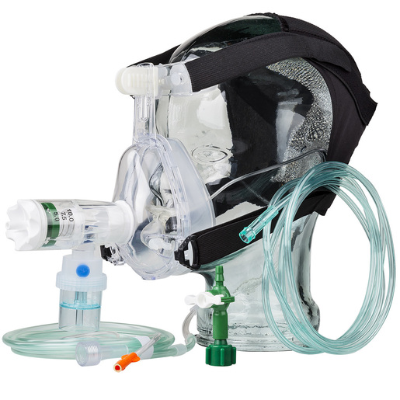
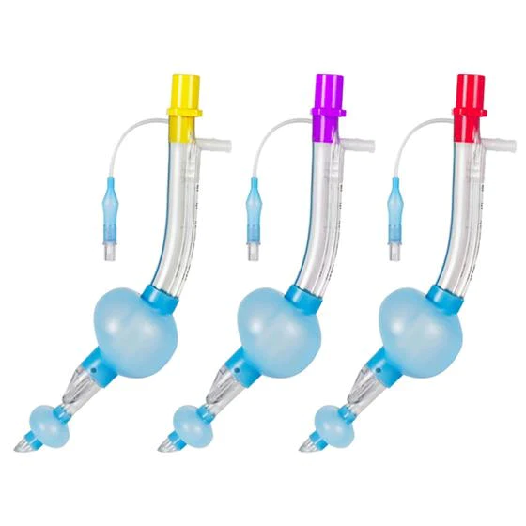
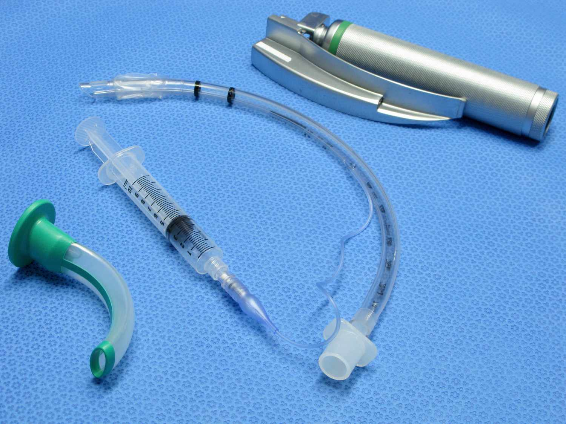
Airway Management
There are the 4 main airway management strategies for EMS providers
Rarely do these airway management strategies fail…but when they do fail…
Notes:
There are the 4 main airway management strategies for EMS providers
(1) Bag-Valve-Mask ventilation which is the fundamental BLS manner in assisting ventilation with or without an oral or nasal airway adjunct but is also a key component to airway management for ALS providers depending on the patient’s anatomy and potential difficult airway situations
And remember the AHA obstructed airway maneuvers if indicated
(2) Non-invasive CPAP (which may be used by BLS providers as well)
(3) oral endo-tracheal intubation by ALS providers
(4) supra-glottic airway placement by ALS providers
Rarely these airway management strategies fail to provide for ventilation of a patient – the “can’t intubate and can’t ventilate” situation which will result in rapid patient demise if not corrected immediately

Slide 4
All Paramedics in Suffolk County are authorized to perform the surgical airway procedure once they have been trained and authorized by their agency medical director
This introductory presentation
Viewing the skills video at the end of this presentation
Attending an in-person hands-on skills training session performed by their agency medical director
Notes:
The emergent surgical airway has been successfully performed by EMS providers for decades all over the world
It is best described as a surgical airway and not as a cricothryotomy in case the trachea is inadvertently incised
The Surgical approach to the procedure has a higher rate of success than Seldinger-technique based procedures
The “Scalpel- Finger-Bougie” technique
This is an EMT-Paramedic skill only

Slide 5
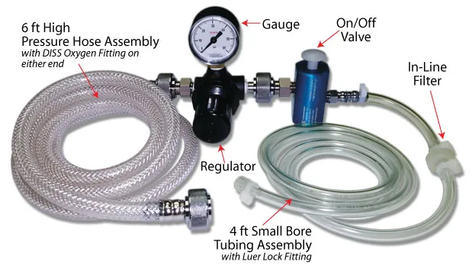
This is a Paramedic skill only, and currently only approved for use in Suffolk County Paramedics AFTER competing the requisite training.
All Paramedics in Suffolk County are still authorized to perform a needle cricothyrotomy with use of a jet insufflator
Suffolk County REMAC has a regional policy that the preferred method is a surgical cricothyrotomy - and not a needle cricothyrotomy or an over-the-wire type procedure
Suffolk County REMAC has asked that all Paramedics be trained in the surgical airway procedure by December 31, 2025
Notes:
Currently all EMT-Paramedics in Suffolk County are authorized to perform a needle cricothyrotomy with use of a jet insufflator for

Slide 6

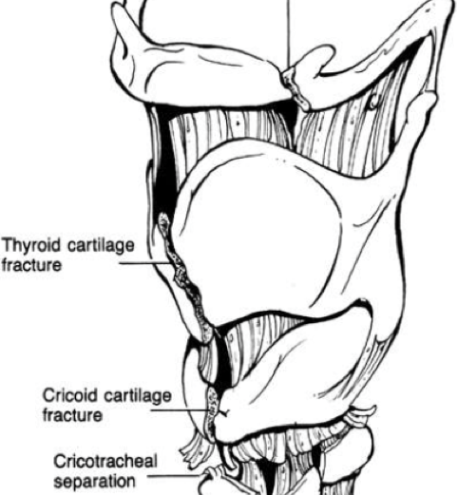
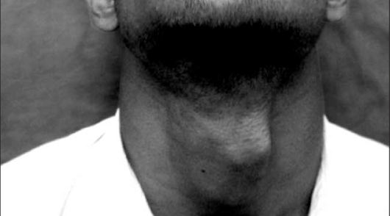
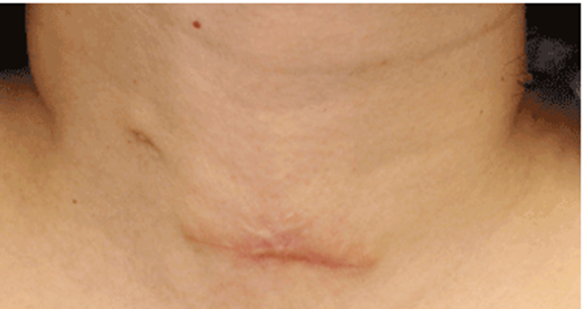
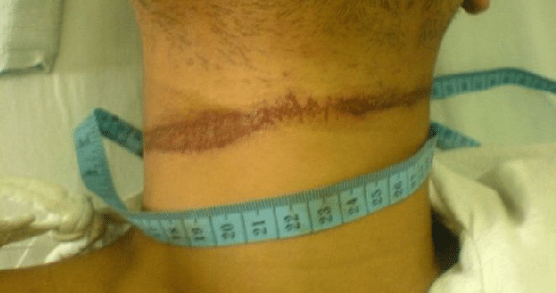
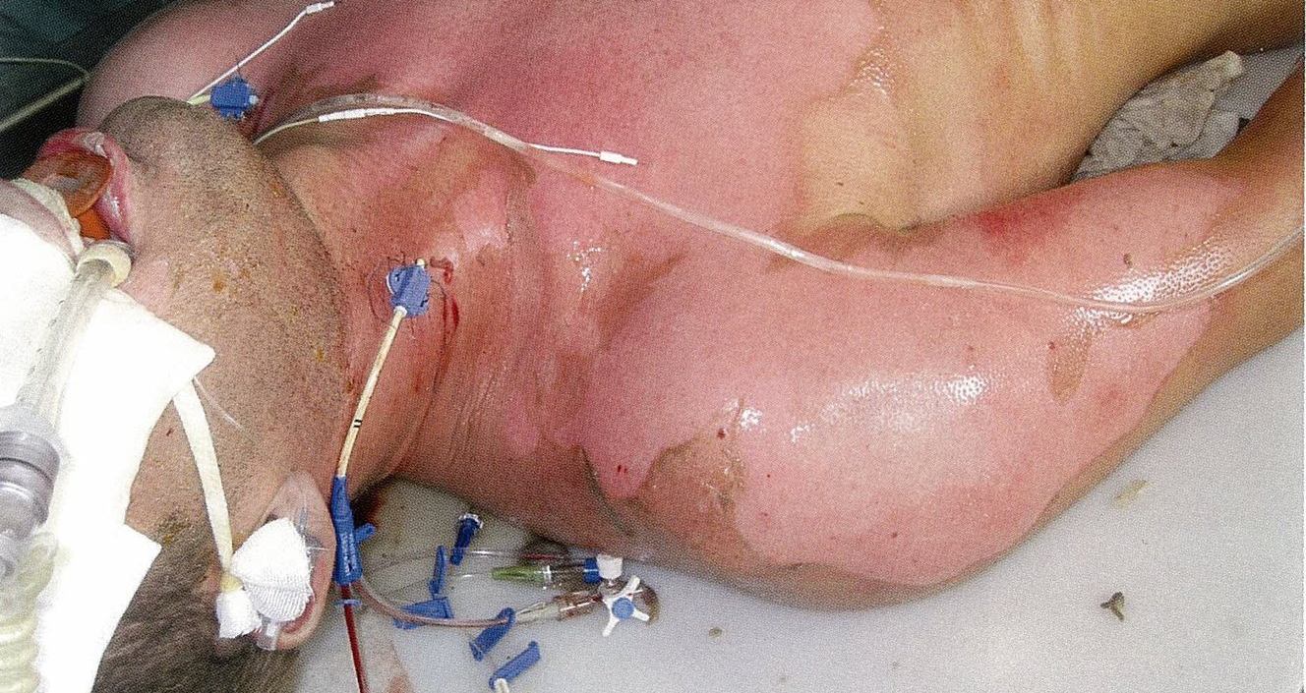
Contraindications to Surgical Airway
Notes:
A pediatric patient age less than 12 – because of the funnel shape to the pediatric larynx and the small diameter of the trachea
Pediatric patients - defined as age less than 15 - currently Suffolk County REMAC does NOT allow for any ALS provider to perform a surgical airway on pediatric patients or to perform a needle cricothyrotomy procedure
Abnormal anatomy over the larynx
Previous surgical scars or tracheostomy
Suspected laryngeal fracture with subcutaneous emphysema, ligature marks, bruising, or palpable crepitation and deformity over the larynx
Open wound, abrasion, ecchymosis, laceration or burn over the anterior neck area

Slide 7
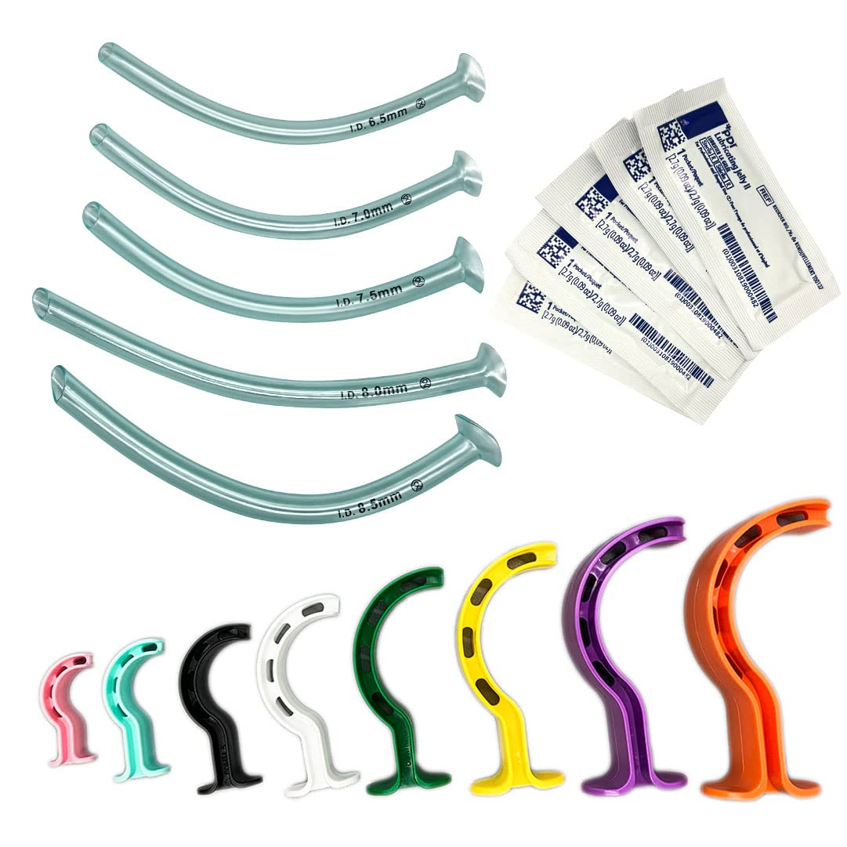
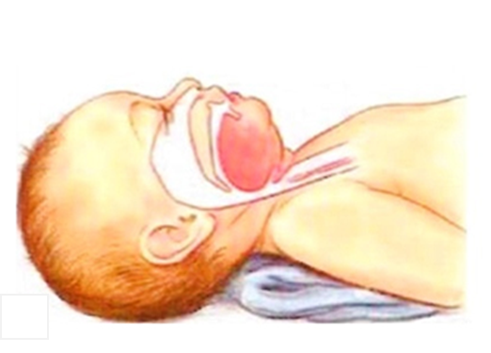
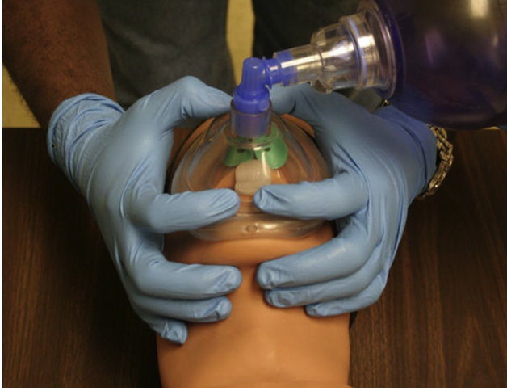
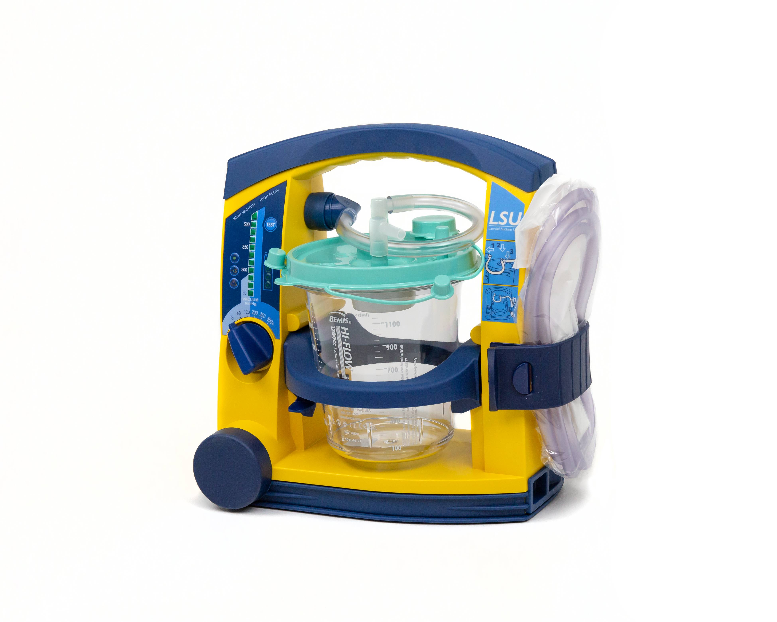
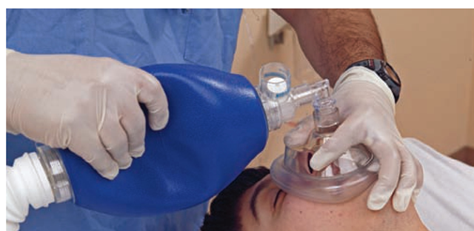
Indications for Surgical Airway
First, try all BLS airway maneuvers
Notes:
(1) BLS Airway Maneuvers with BVM, mask seal, oral and/or nasal airway adjuncts, patient positioning and padding under the shoulders, suctioning, 2 hand mask seal technique with additional provider to assist with the bag insufflation

Slide 8
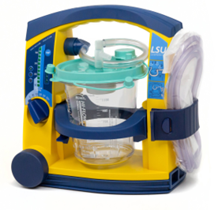
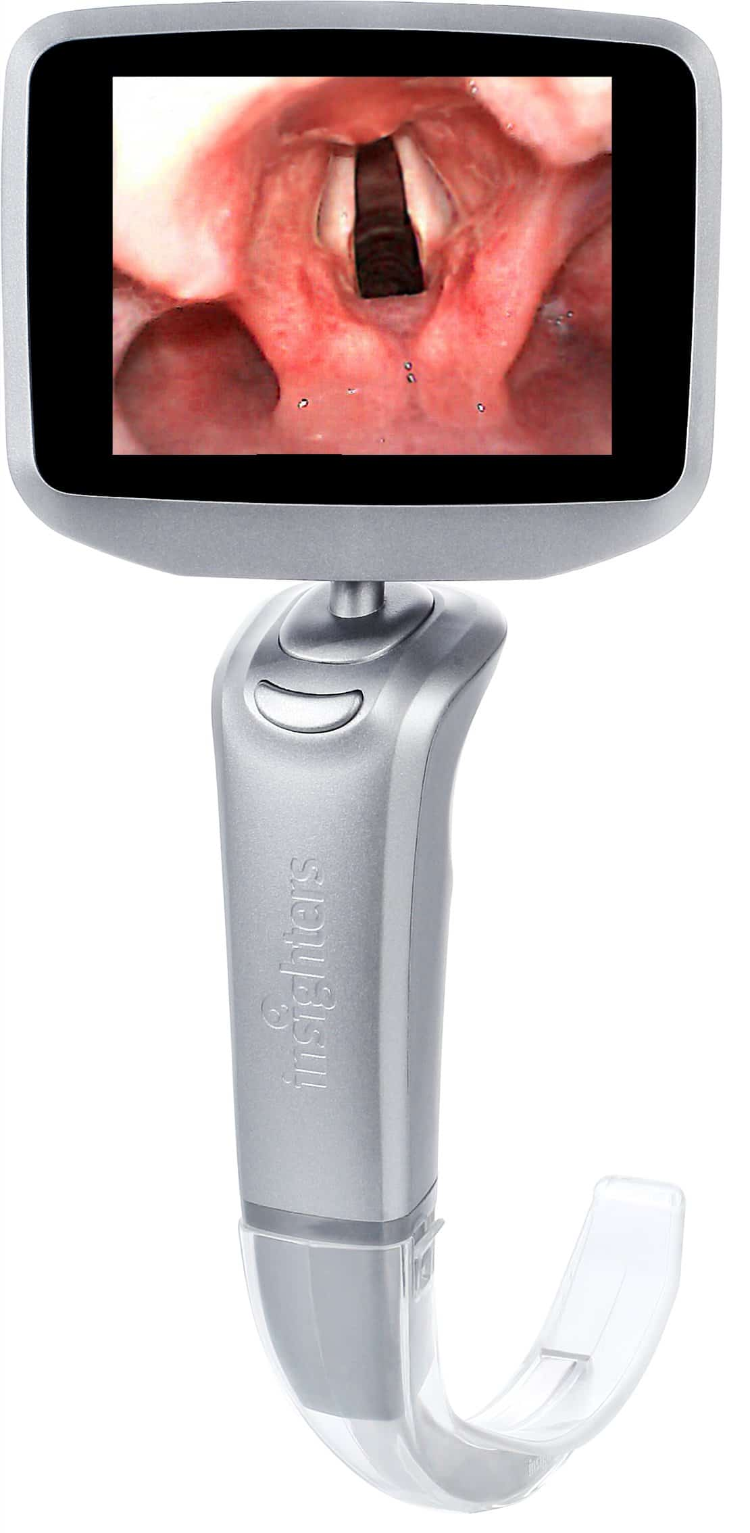
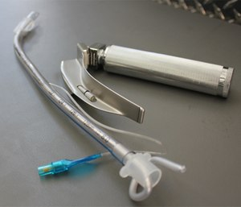
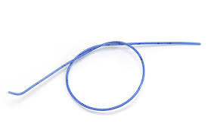
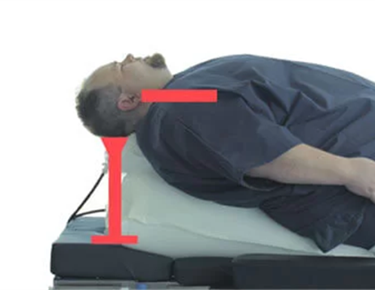
Indications for Surgical Airway
Second, attempt intubation
Notes:
(2) Oral endo-tracheal tube placement, with suctioning, with a rigid stylet, with the use of a bougie, with video laryngoscope, with direct laryngoscope, with patient positioning and padding under the shoulders – maximum of two attempts at tube passage by one provider

Slide 9
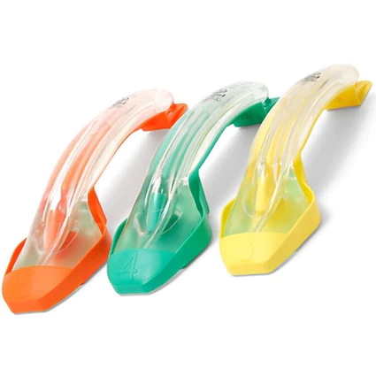
Indications for Surgical Airway
Third, attempt to place a supraglottic airway
Notes:
(3) Supra-glottic airway placement – which is highly successful

Slide 10
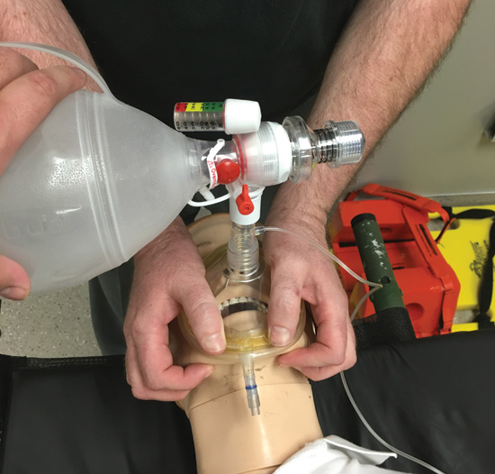
Indications for Surgical Airway
Fourth, try one last attempt to ventilate using BLS airway techniques
Notes:
(4) BLS Airway Maneuvers with BVM one last attempt to ventilate the patient- and if it fails, now you have defined a patient that cannot be intubated and cannot be ventilated

Slide 11
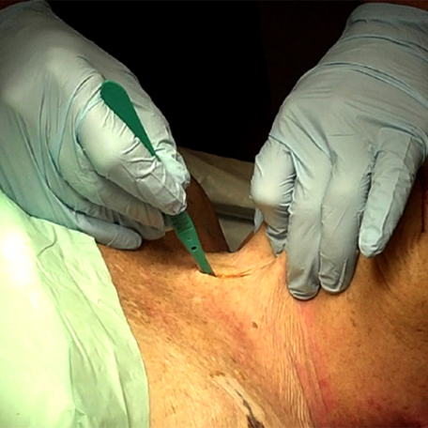
Indications for Surgical Airway
Finally, attempt a surgical airway
Notes:
(5) Surgical Airway

Slide 12
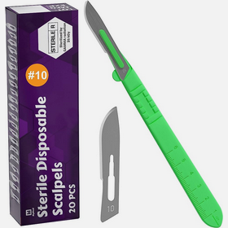
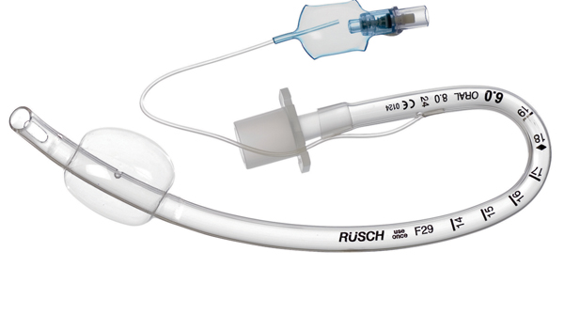

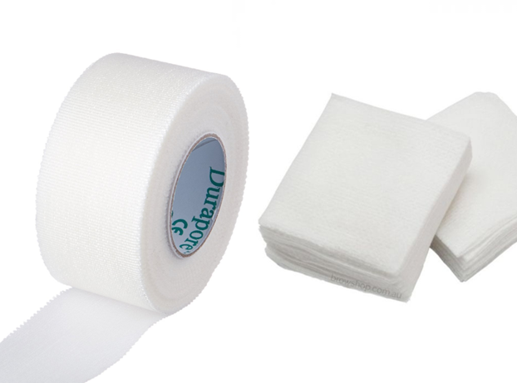
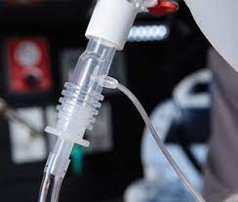
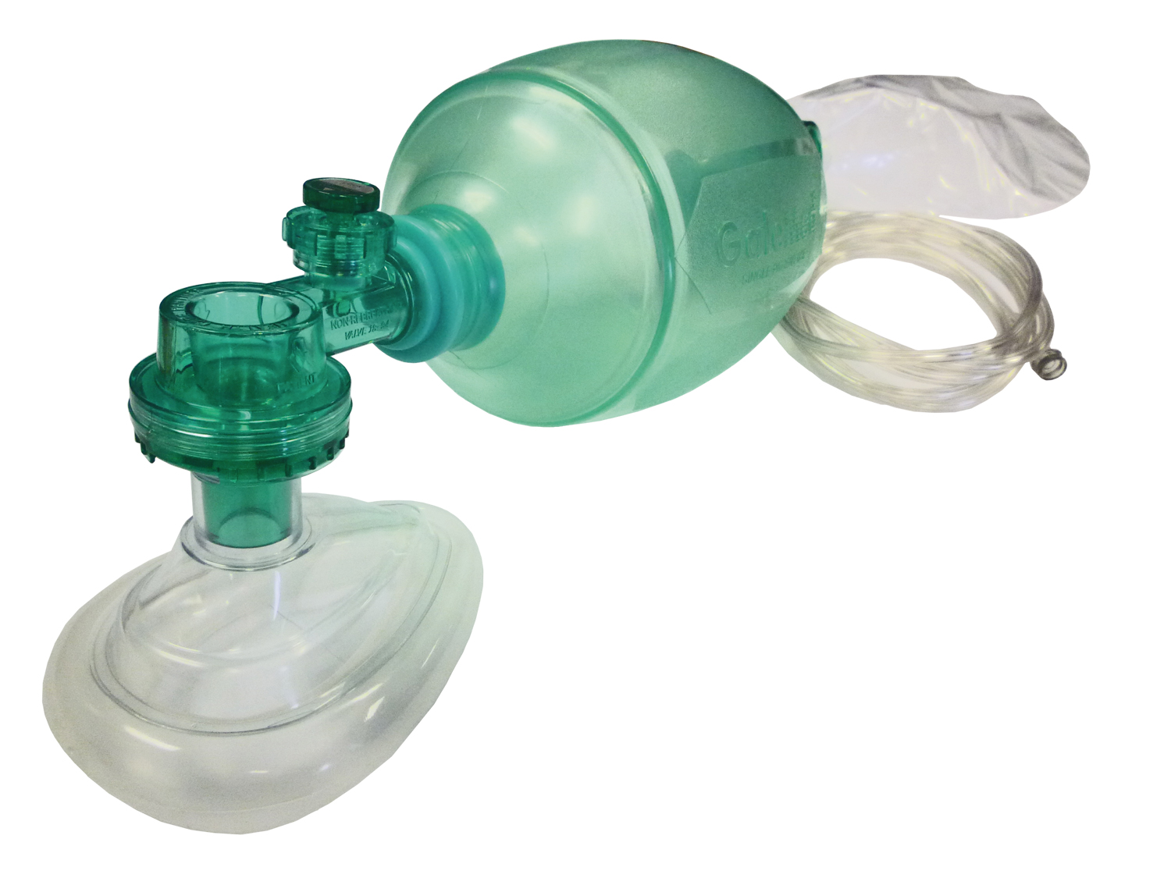
Equipment
Scalpel (No 10 is best- and have an extra)
Bougie
6-0 Endo-tracheal tube with a cuff (have an extra)
Gauze to pack the surgical wound (that will be bleeding)
Tape to secure the tube in place
BVM
Wave-from capnography monitoring
Notes:
Scalpel (No 10 is best) and an extra in case you drop/break it
Bougie
6-0 Endo-tracheal tube with a cuff and an extra one in case you drop/damage it
Gauze to pack the surgical wound that will be bleeding and to assist with securing the tube in place
Tape to secure the tube in place
BVM and wave-from capnography monitoring

Slide 13
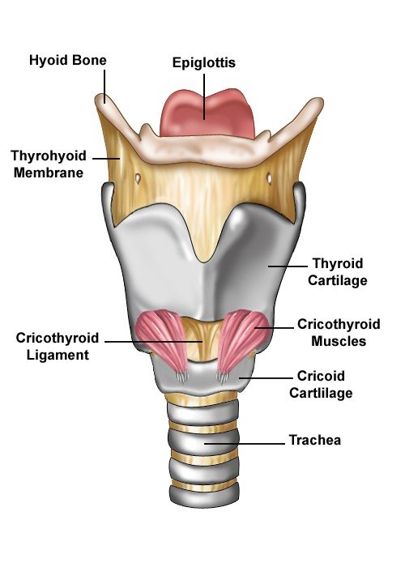
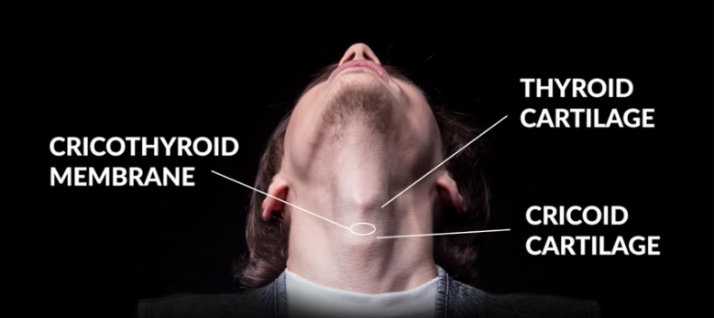
The Surgical Airway Procedure
Use non-dominant hand to palpate the landmarks over the anterior neck to identify the larynx and the cricothyroid membrane
Notes:
Use non-dominant hand to palpate the landmarks over the anterior neck to identify the larynx and the cricothyroid membrane specifically

Slide 14
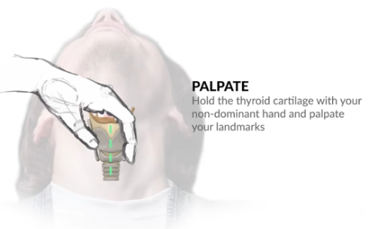
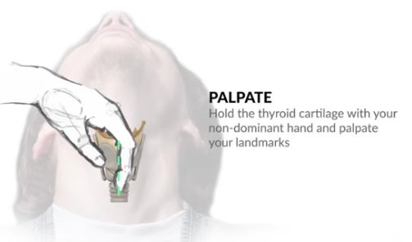
Use the index finger to palpate the cricothyroid membrane while using the thumb and second finger to stabilize the larynx and continue to hold the larynx with the non-dominant hand throughout the procedure
Notes:
Use the index finger to palpate the cricothyroid membrane while using the thumb and second finger to stabilize the larynx and continue to hold the larynx with the non-dominant hand throughout the procedure

Slide 15
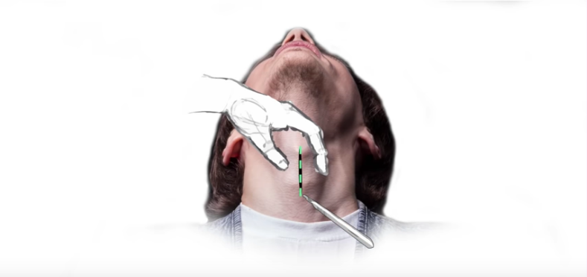
Take the scalpel with the dominant hand and make a 4cm vertical incision (down the length of the body and not across it) through the skin overlying the cricothyroid membrane – deep enough to get through all layers of skin and down onto the cartilages
Expect that this will be very bloody, and you need to move quickly
Notes:
Take the scalpel with the dominant hand and make a 4cm vertical incision (down the length of the body and not across it) through the skin overlying the cricothyroid membrane – deep enough to get through all layers of skin and down onto the cartilages
Expect that this will be very bloody and you need to move quickly

Slide 16
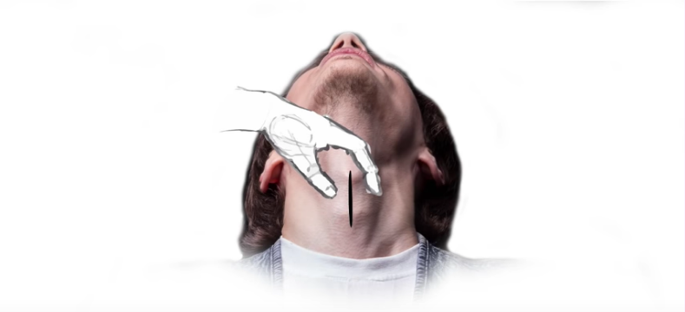
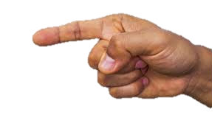
With the dominant hand, insert your index finger into the surgical wound and bluntly dissect down and around to make a hole
Notes:
With the dominant hand, insert your index finger into the surgical wound and bluntly dissect down and around to make a hole and to identify the cricothyroid membrane (careful with the scalpel because you have to lay it down for a few seconds and then pick it up again)

Slide 17
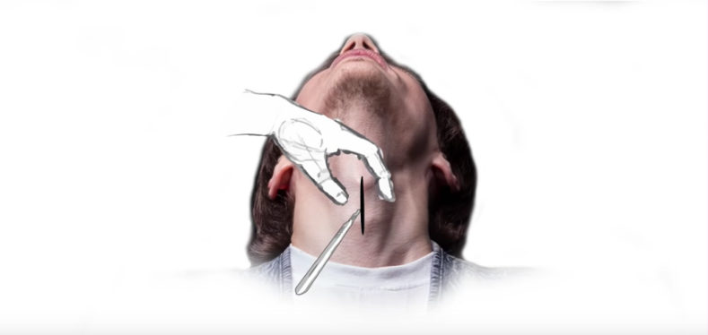
With the dominant hand, take up the scalpel and cut into the cricothyroid membrane making a horizontal incision
Notes:
With the dominant hand, take up the scalpel and cut into the cricothyroid membrane making a horizontal incision

Slide 18
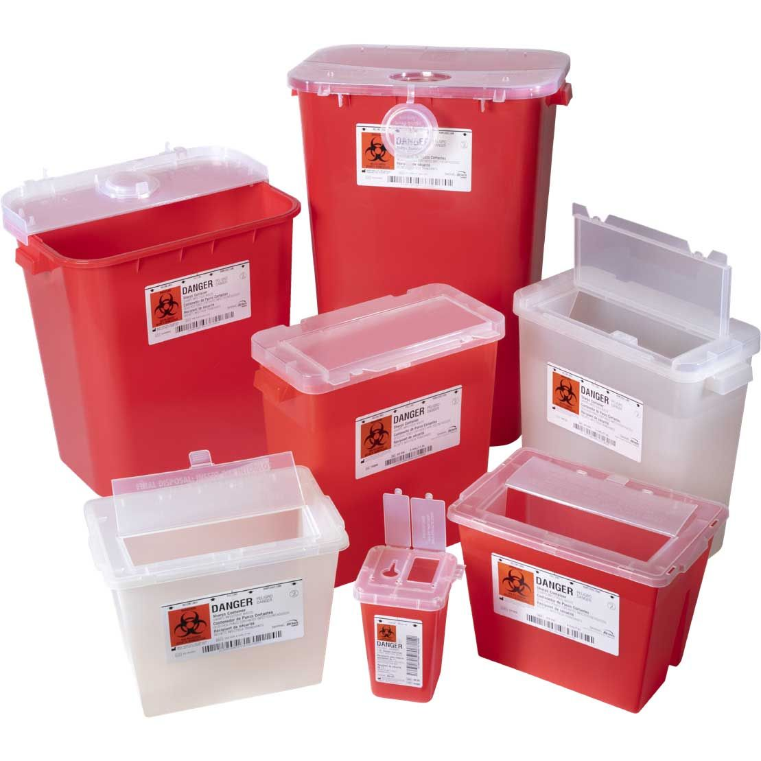
Appropriately dispose of the scalpel
Notes:
You may put away the scalpel now and dispose of safely

Slide 19
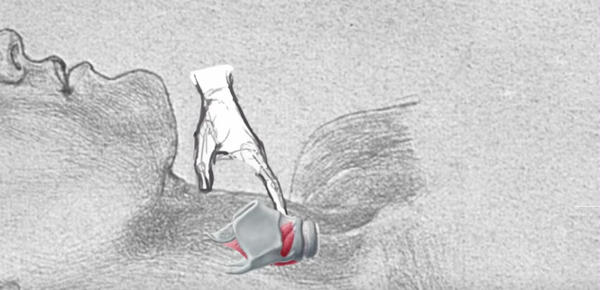
With the dominant hand, insert your index finger into the cricothyroid membrane and enlarge the hole
Notes:
With the dominant hand, insert your index finger into the cricothyroid membrane and enlarge the hole

Slide 20
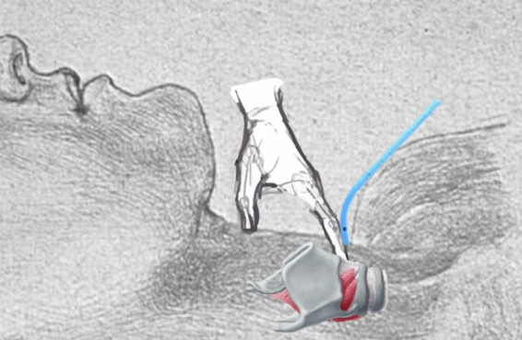
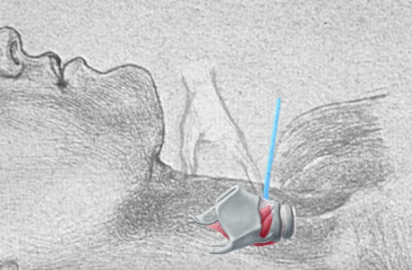
Put the bougie into the hole in the cricothyroid membrane, guiding it to go down into the trachea, towards the patient’s feet
Notes:
Put the bougie into the hole in the cricothyroid membrane, guiding it to go down into the trachea towards the patient’s feet

Slide 21


Pass a 6-0 cuffed endo-tracheal tube over the bougie and into the trachea. Once the balloon is no longer visible, remove the bougie, inflate the cuff, and secure the tube in place with tape and gauze and/or a commercial tube holder device
Notes:
Pass a 6-0 cuffed endo-tracheal tube over the bougie and into the trachea, and once the balloon is no longer visible, inflate the cuff, and secure the tube in place with tape and gauze and/or tube holder device

Slide 22
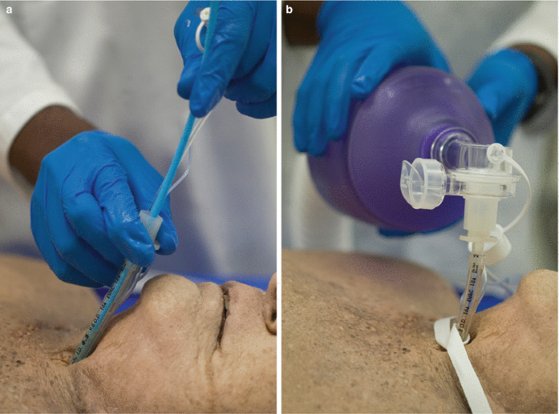
Attach a BVM to the endo-tracheal tube and ventilate the patient
Notes:
Attach a BVM to the endo-tracheal tube and ventilate the patient

Slide 23
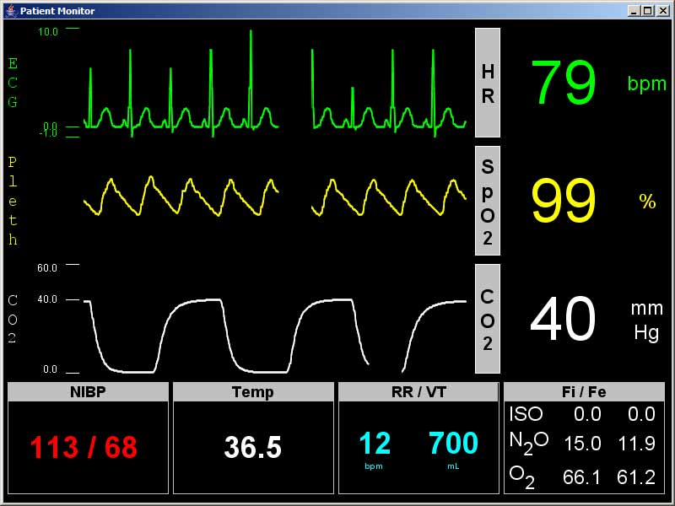
Check for wave-form capnography to confirm proper tracheal placement
Notes:
Check for wave-form capnography to confirm proper tracheal placement

Slide 24

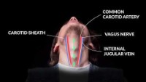
How to Perform an Emergency Cricothyrotomy by Justin Henneman
Notes:
After viewing this brief presentation, please review Youtube video “How to perform an emergency crico-thyrotomy” by Justin Henneman

Slide 25



Remember…
Final authorization to perform the surgical airway procedure will be made by the Agency Medical Director after an in-person hands-on skills training session
Notes:
Final authorization to perform the surgical airway procedure will be made by the agency medical director after an in-person hands-on skills training session

Slide 26
Resource Links for Surgical Airways Training
https://protect-us.mimecast.com/s/Qx_4C5yv7rCZgRY3Szm3-c?domain=youtube.com
https://protect-us.mimecast.com/s/V8DLC68wWvhrVMl7i6jJdM?domain=litfl.com/

Slide 27

Thank you!
This has been a presentation from The Suffolk County Regional Emergency Medical Advisory Committee and the Suffolk County Program Agency
Narrator – Dr Jason Winslow

